Slide 1

UWB Association for Computing Machinery (ACM)

Slide 2
What is ACM?
The mission of our student chapter is to promote the advancement of technological awareness and provide educational and professional opportunities for students of the University of Washington, Bothell campus.

Slide 3
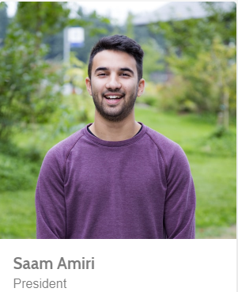
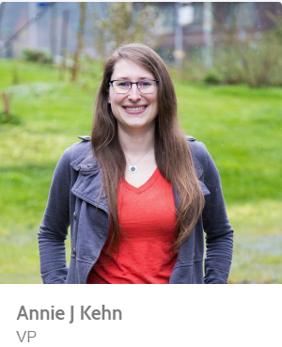
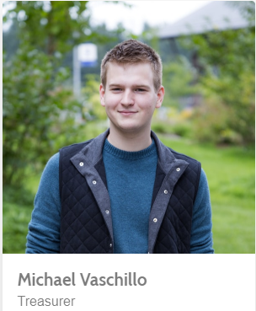
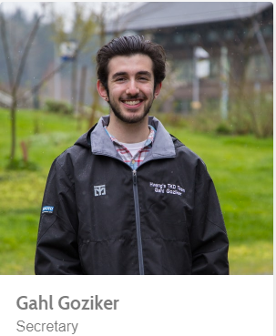
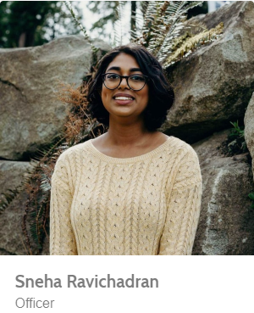
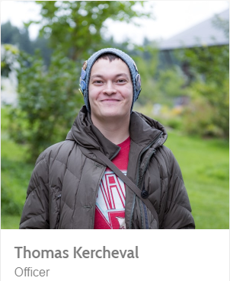
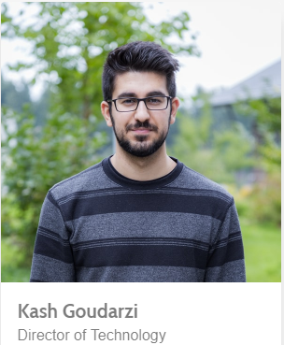
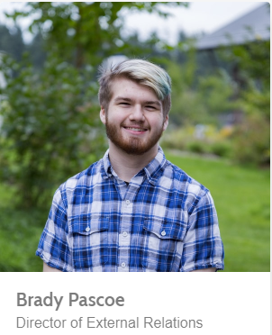
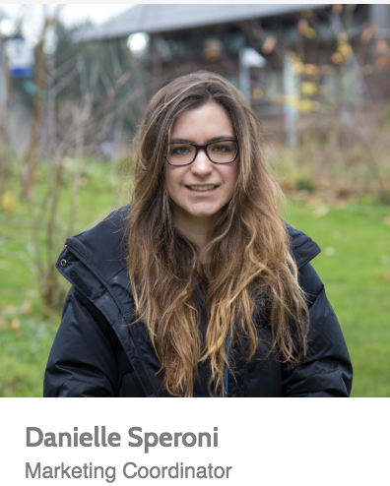
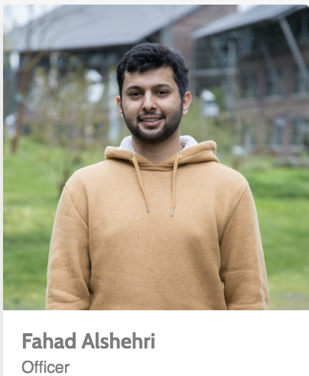
2018-2019 UWB ACM TEAM

Slide 4
2017-2018 UWB ACM Events
Fall Quarter
Technical Resume Workshop
Crack the Coding Interview Workshop
Fall Quarter Finals Study Session
Winter Quarter
3-Session Python Workshop
Tech Industry Panel & Networking Mixer
Weekly Crack the Coding Interview Workshop
Winter Quarter Finals Study Session
Spring Quarter
3-Session Github/Open Source Workshop
Microsoft Coffee & Career Chat
UWB HACKS- Bot Development Hackathon
Weekly Crack the Coding Interview Workshop
Spring Quarter Finals Study Session

Slide 5
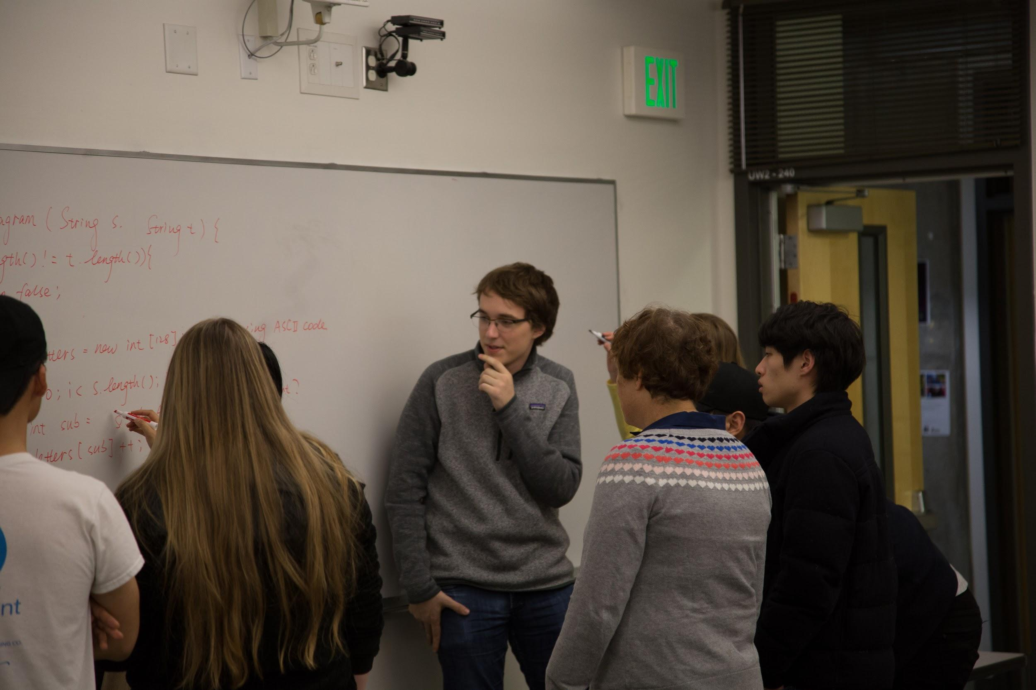
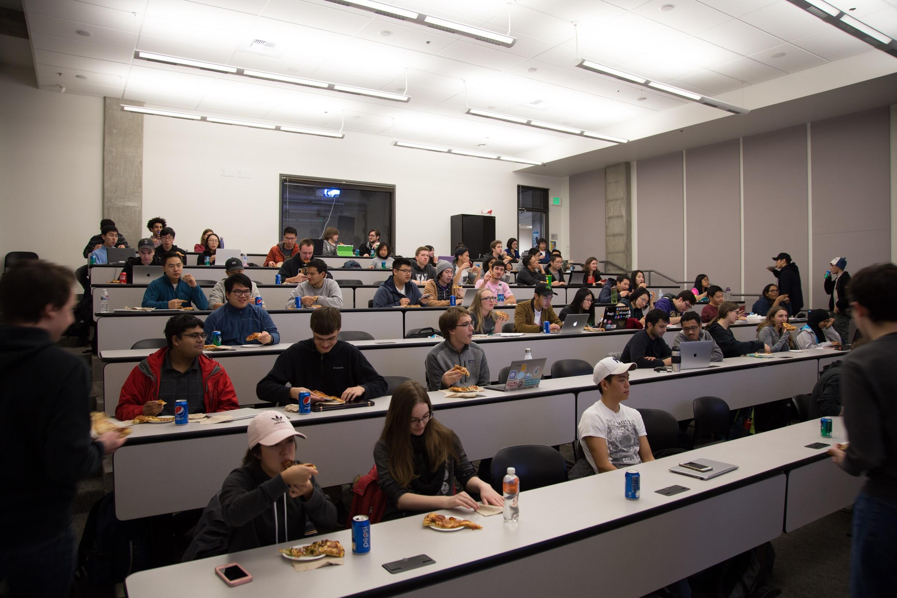
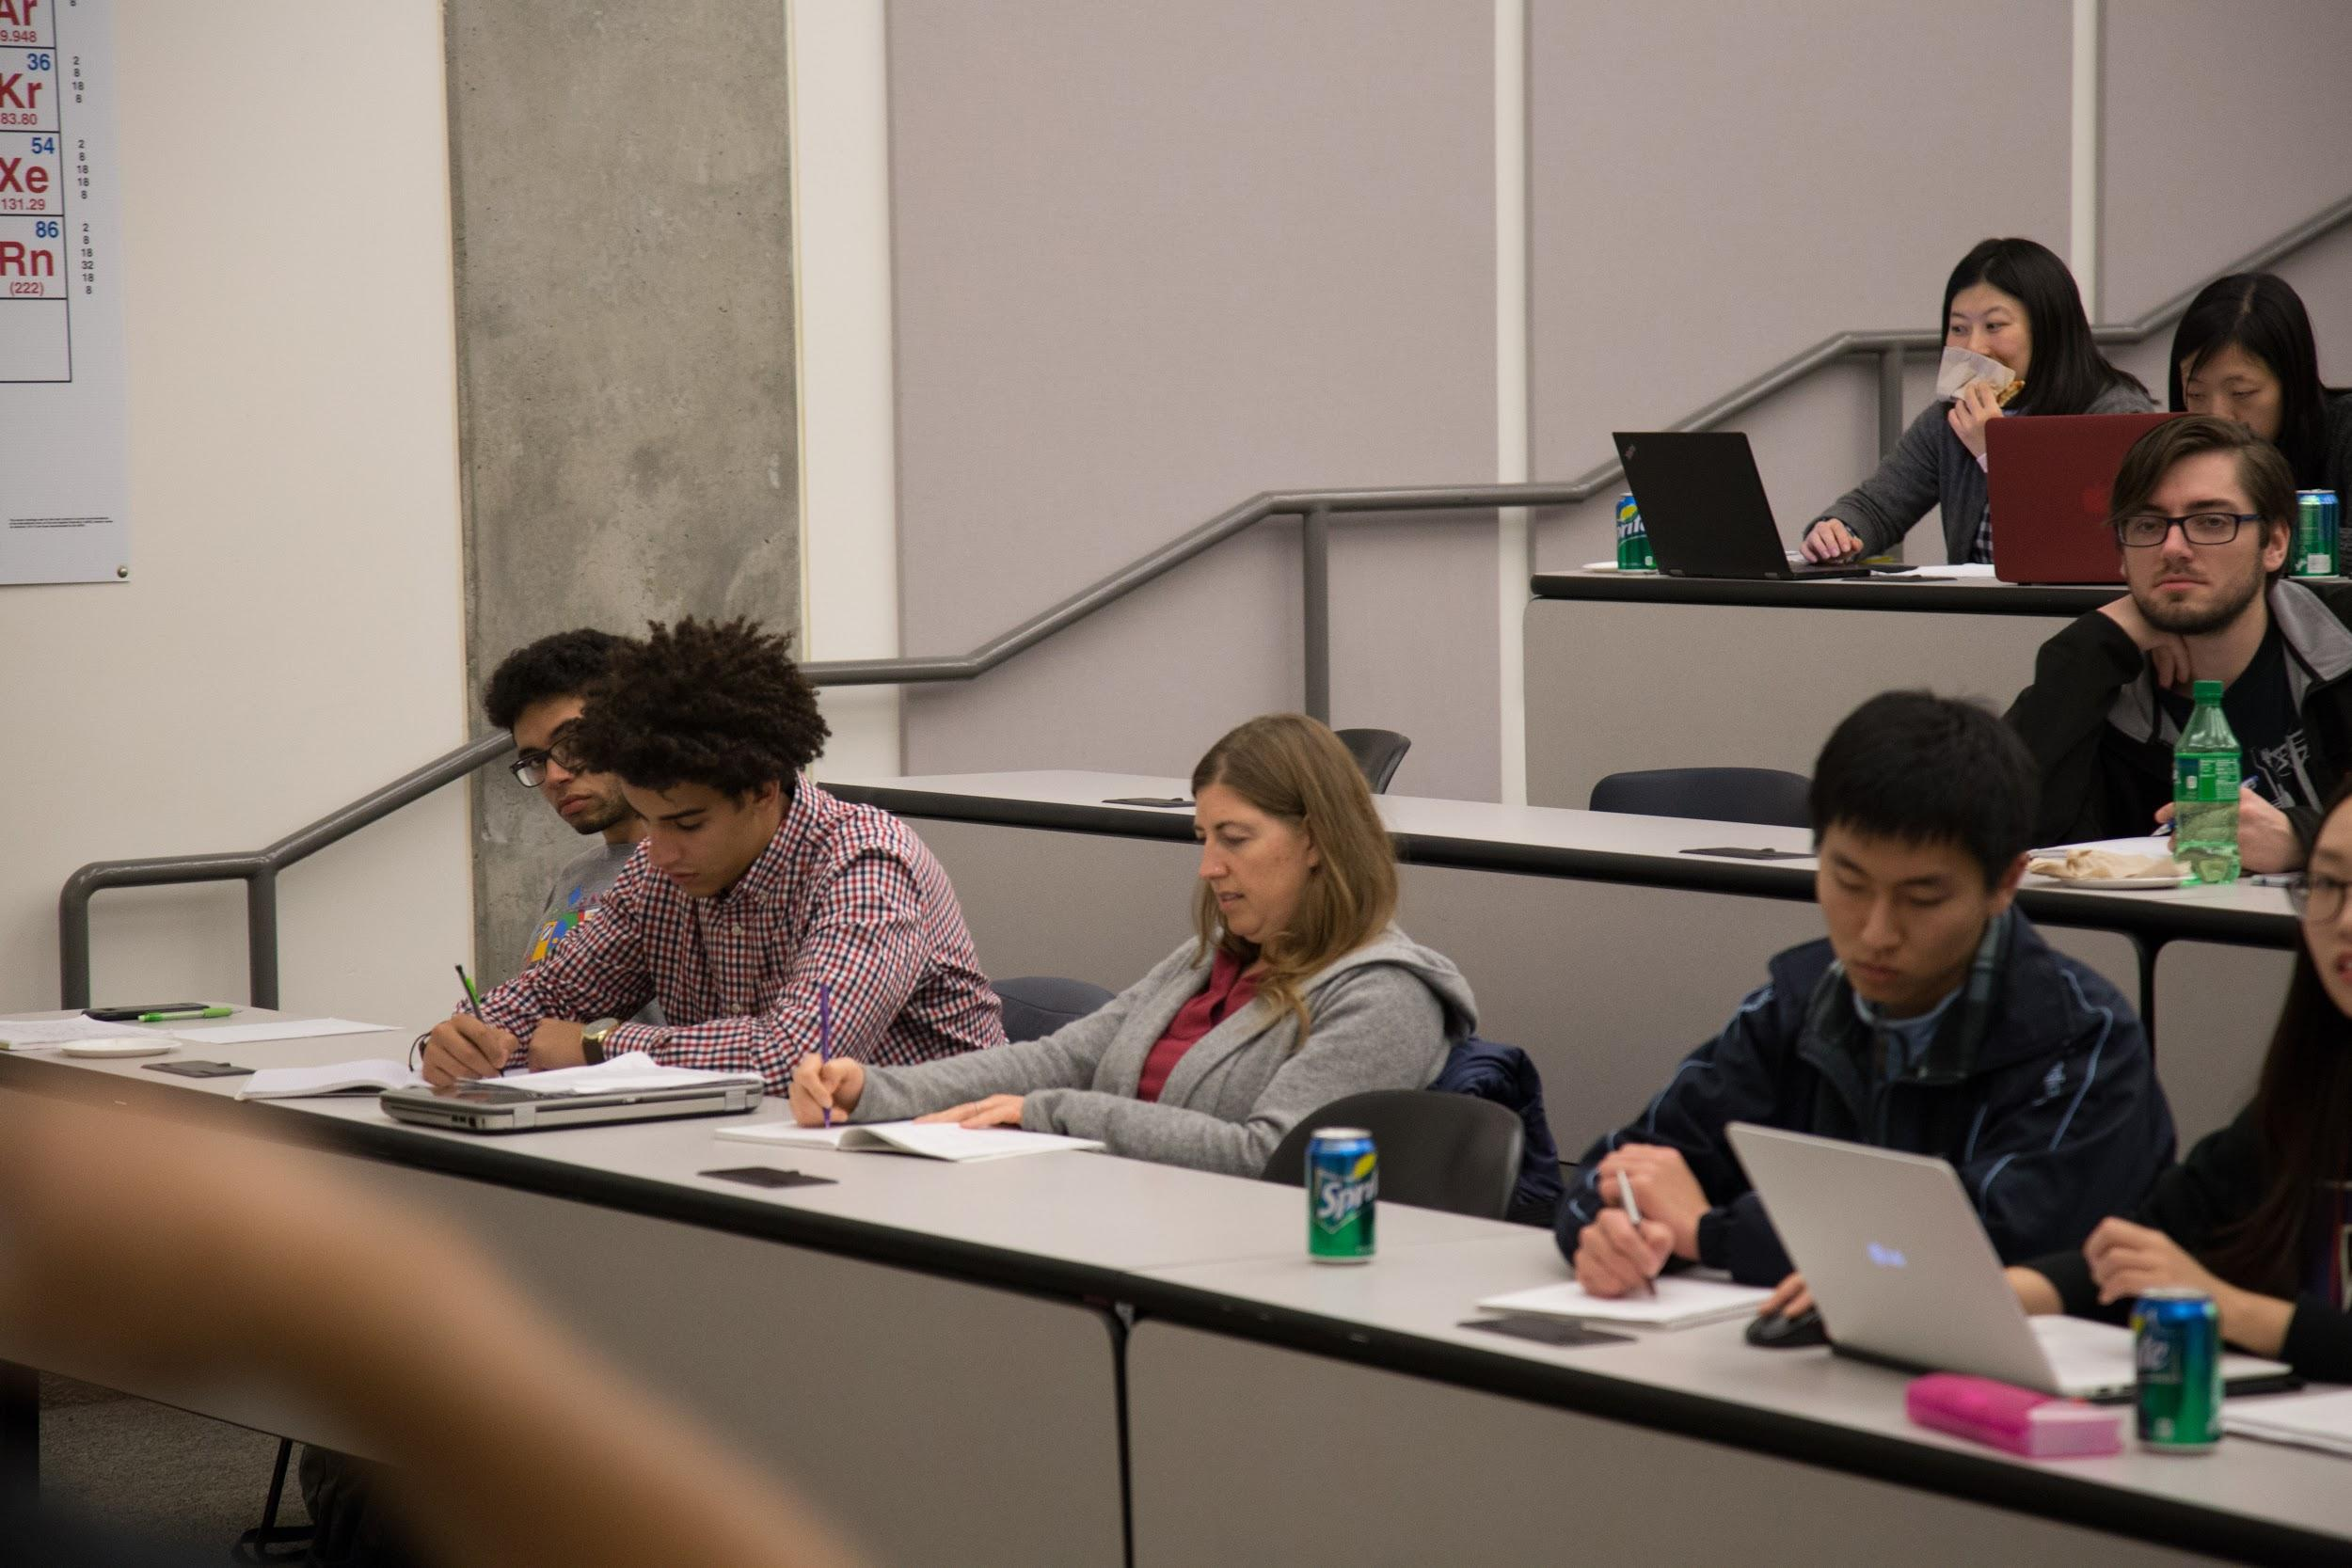
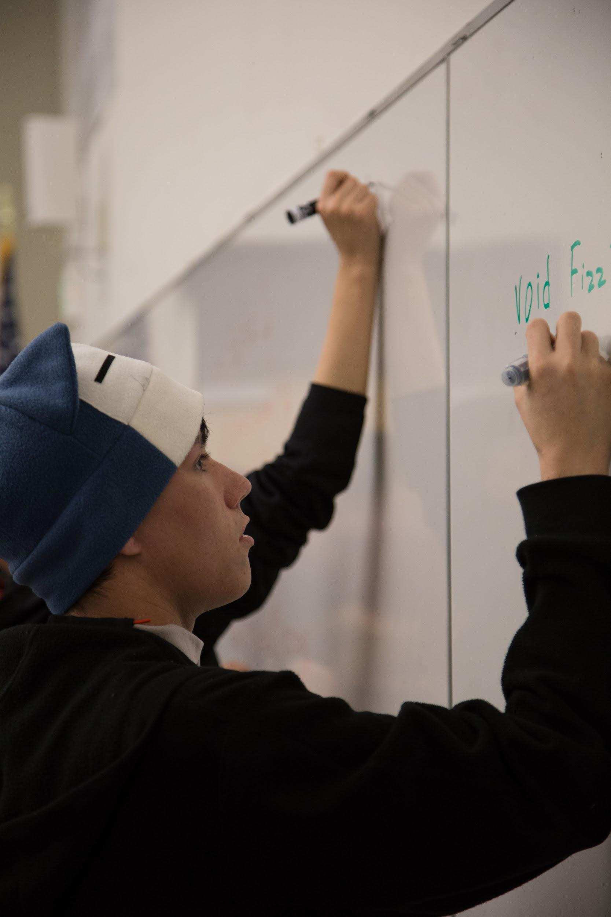
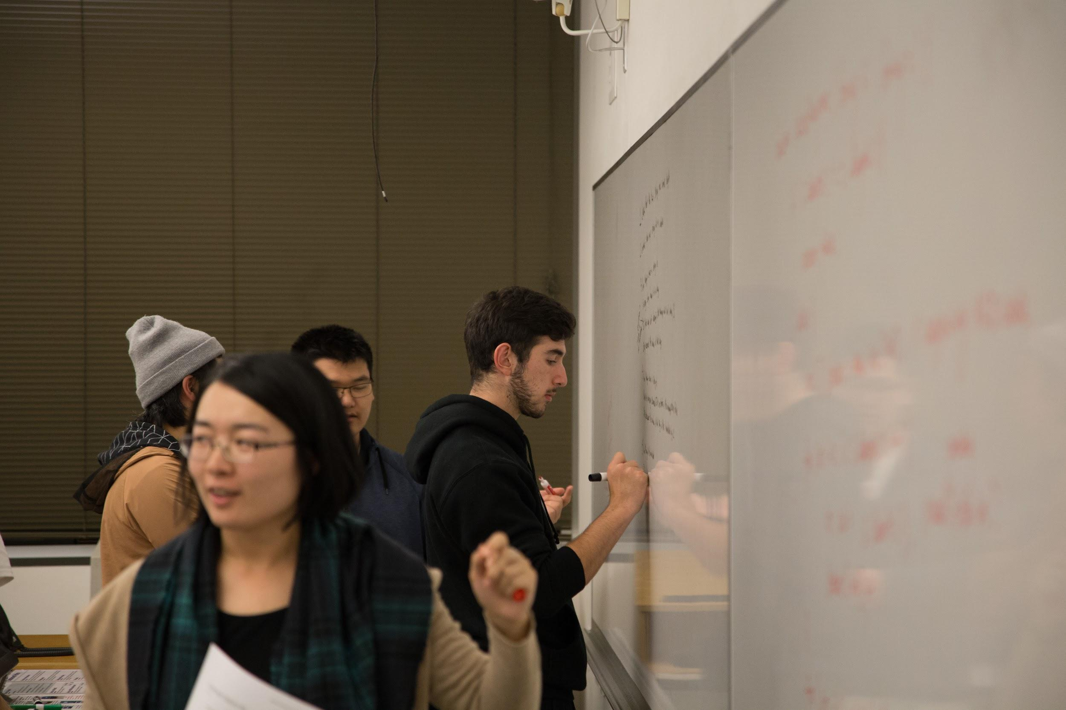
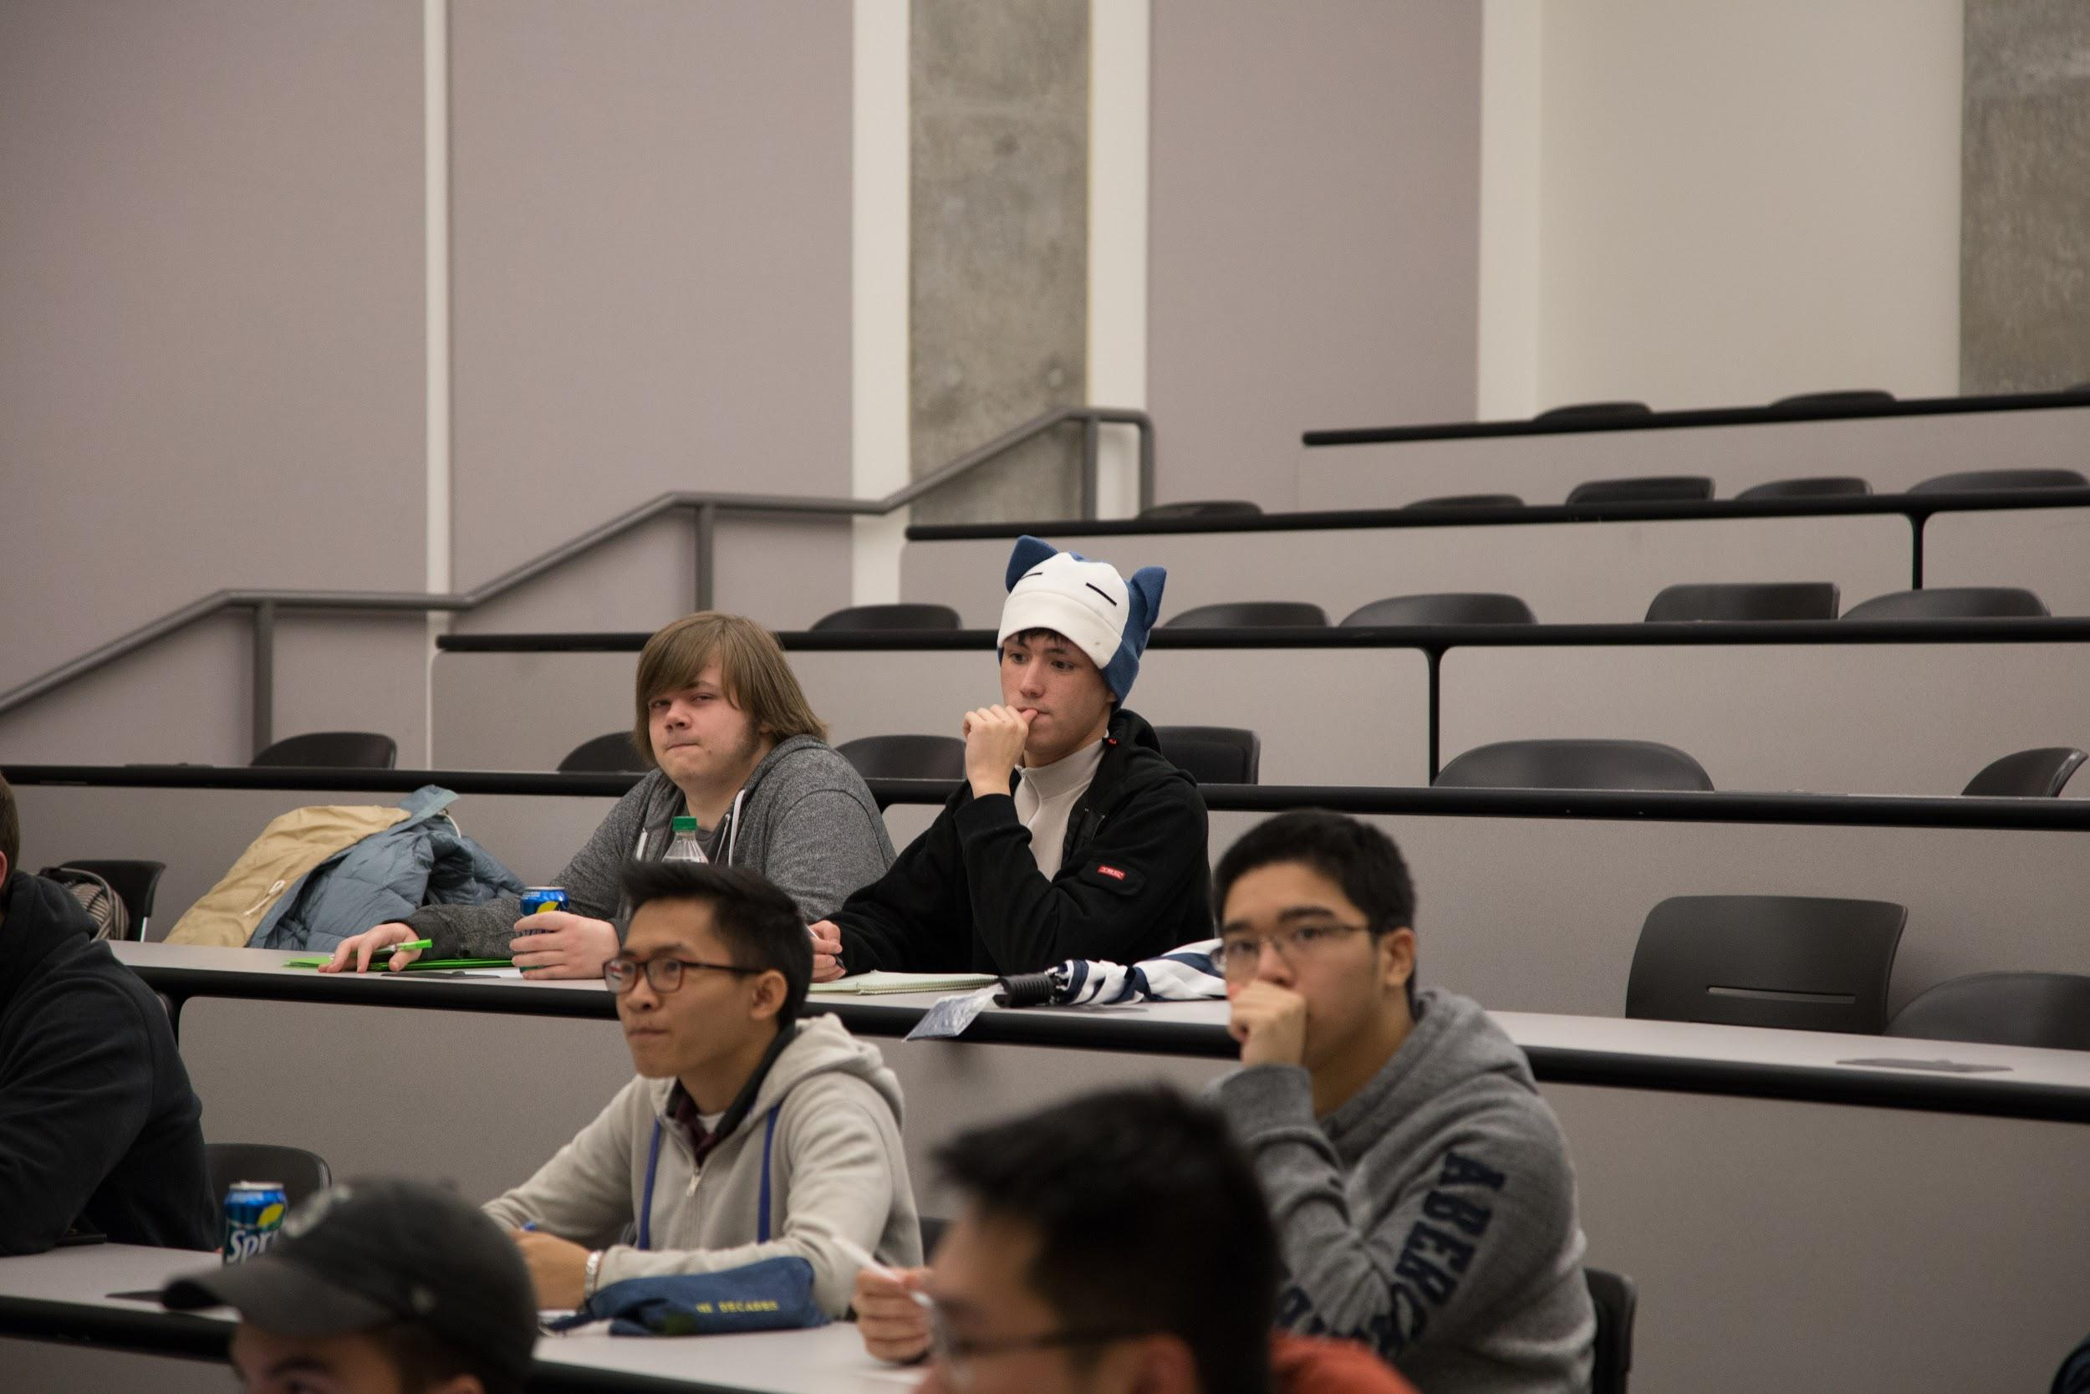
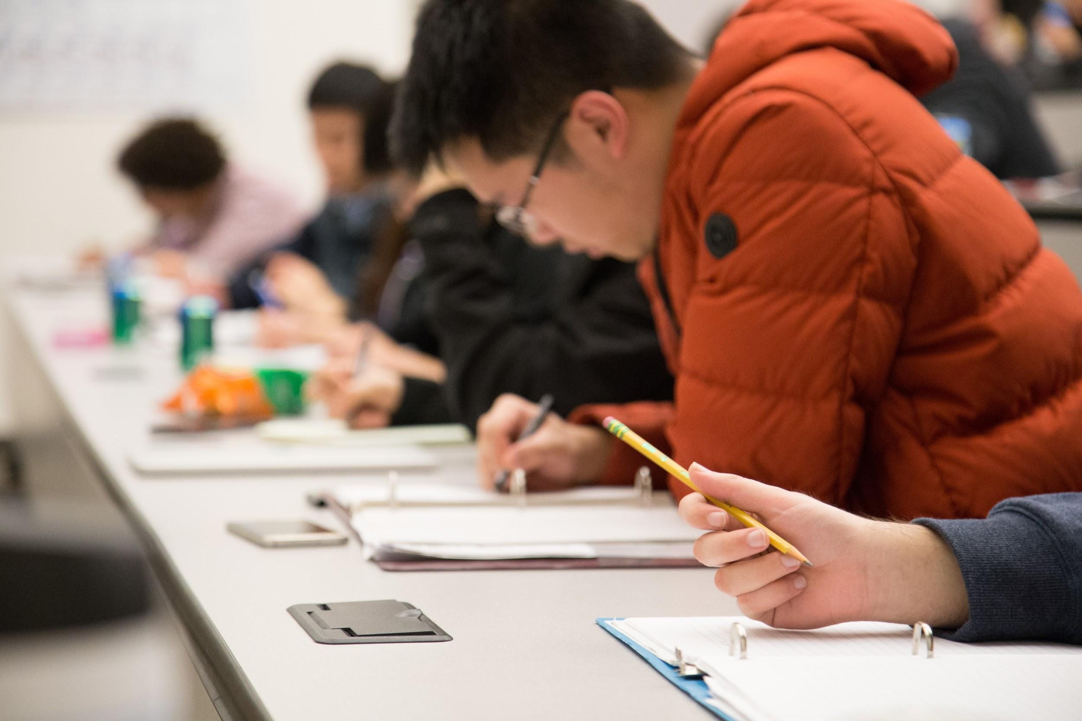
Past Events - Crack the Coding Interview Workshop

Slide 6
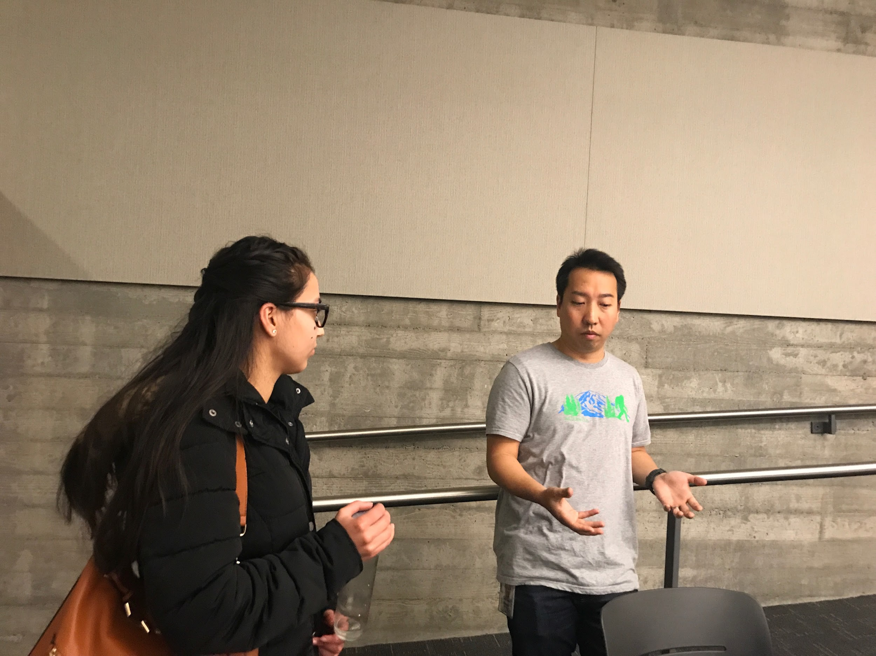
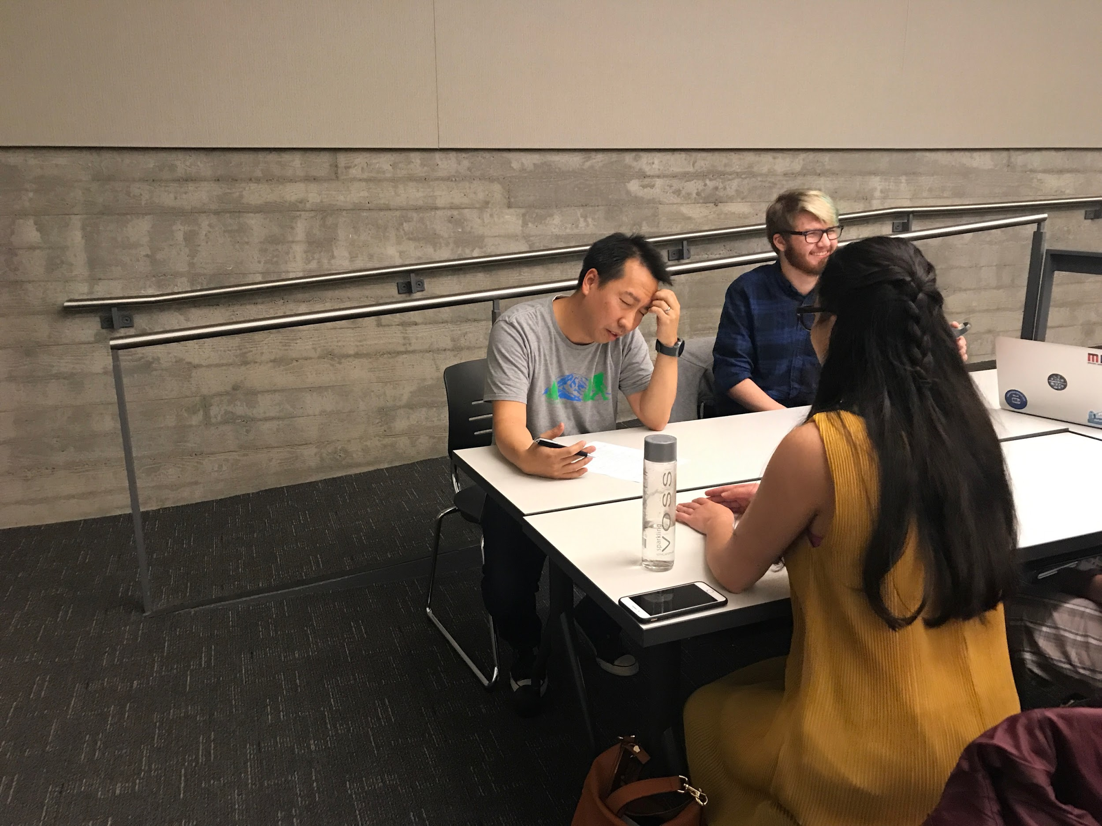
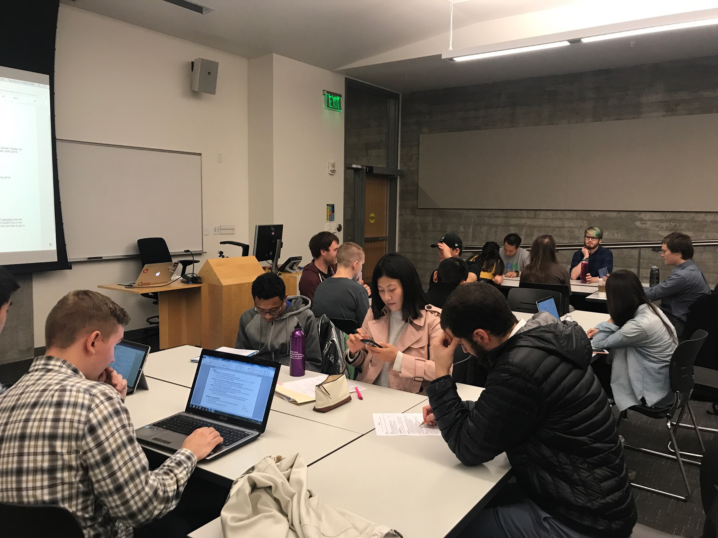
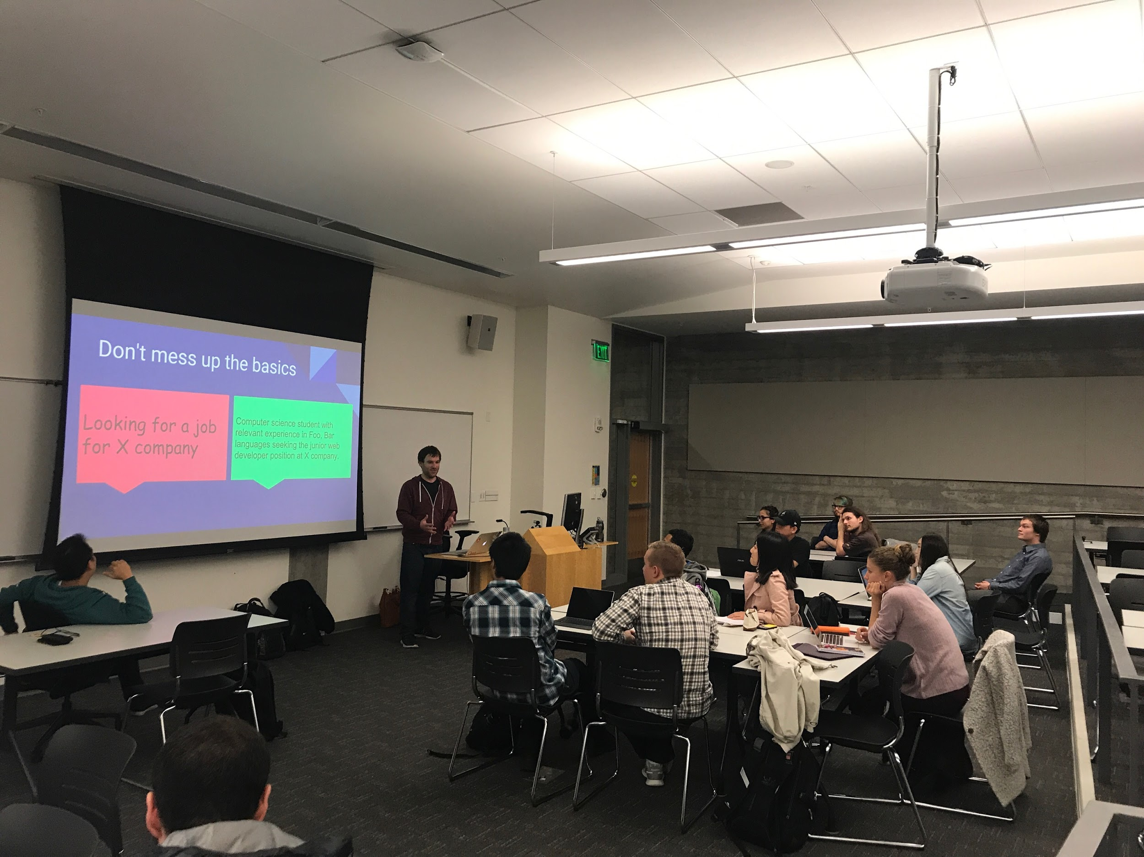
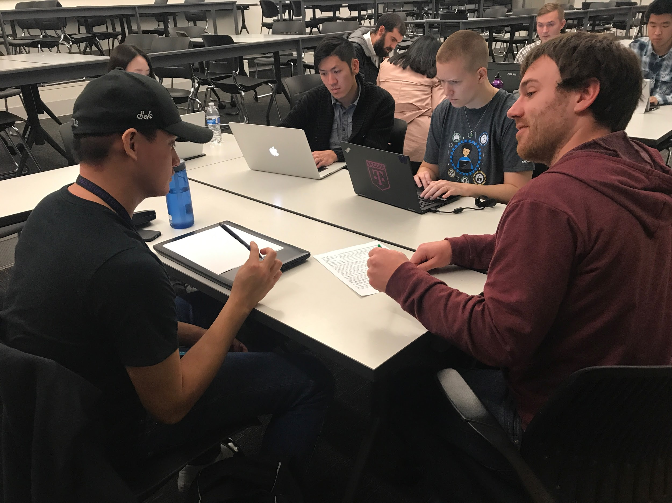
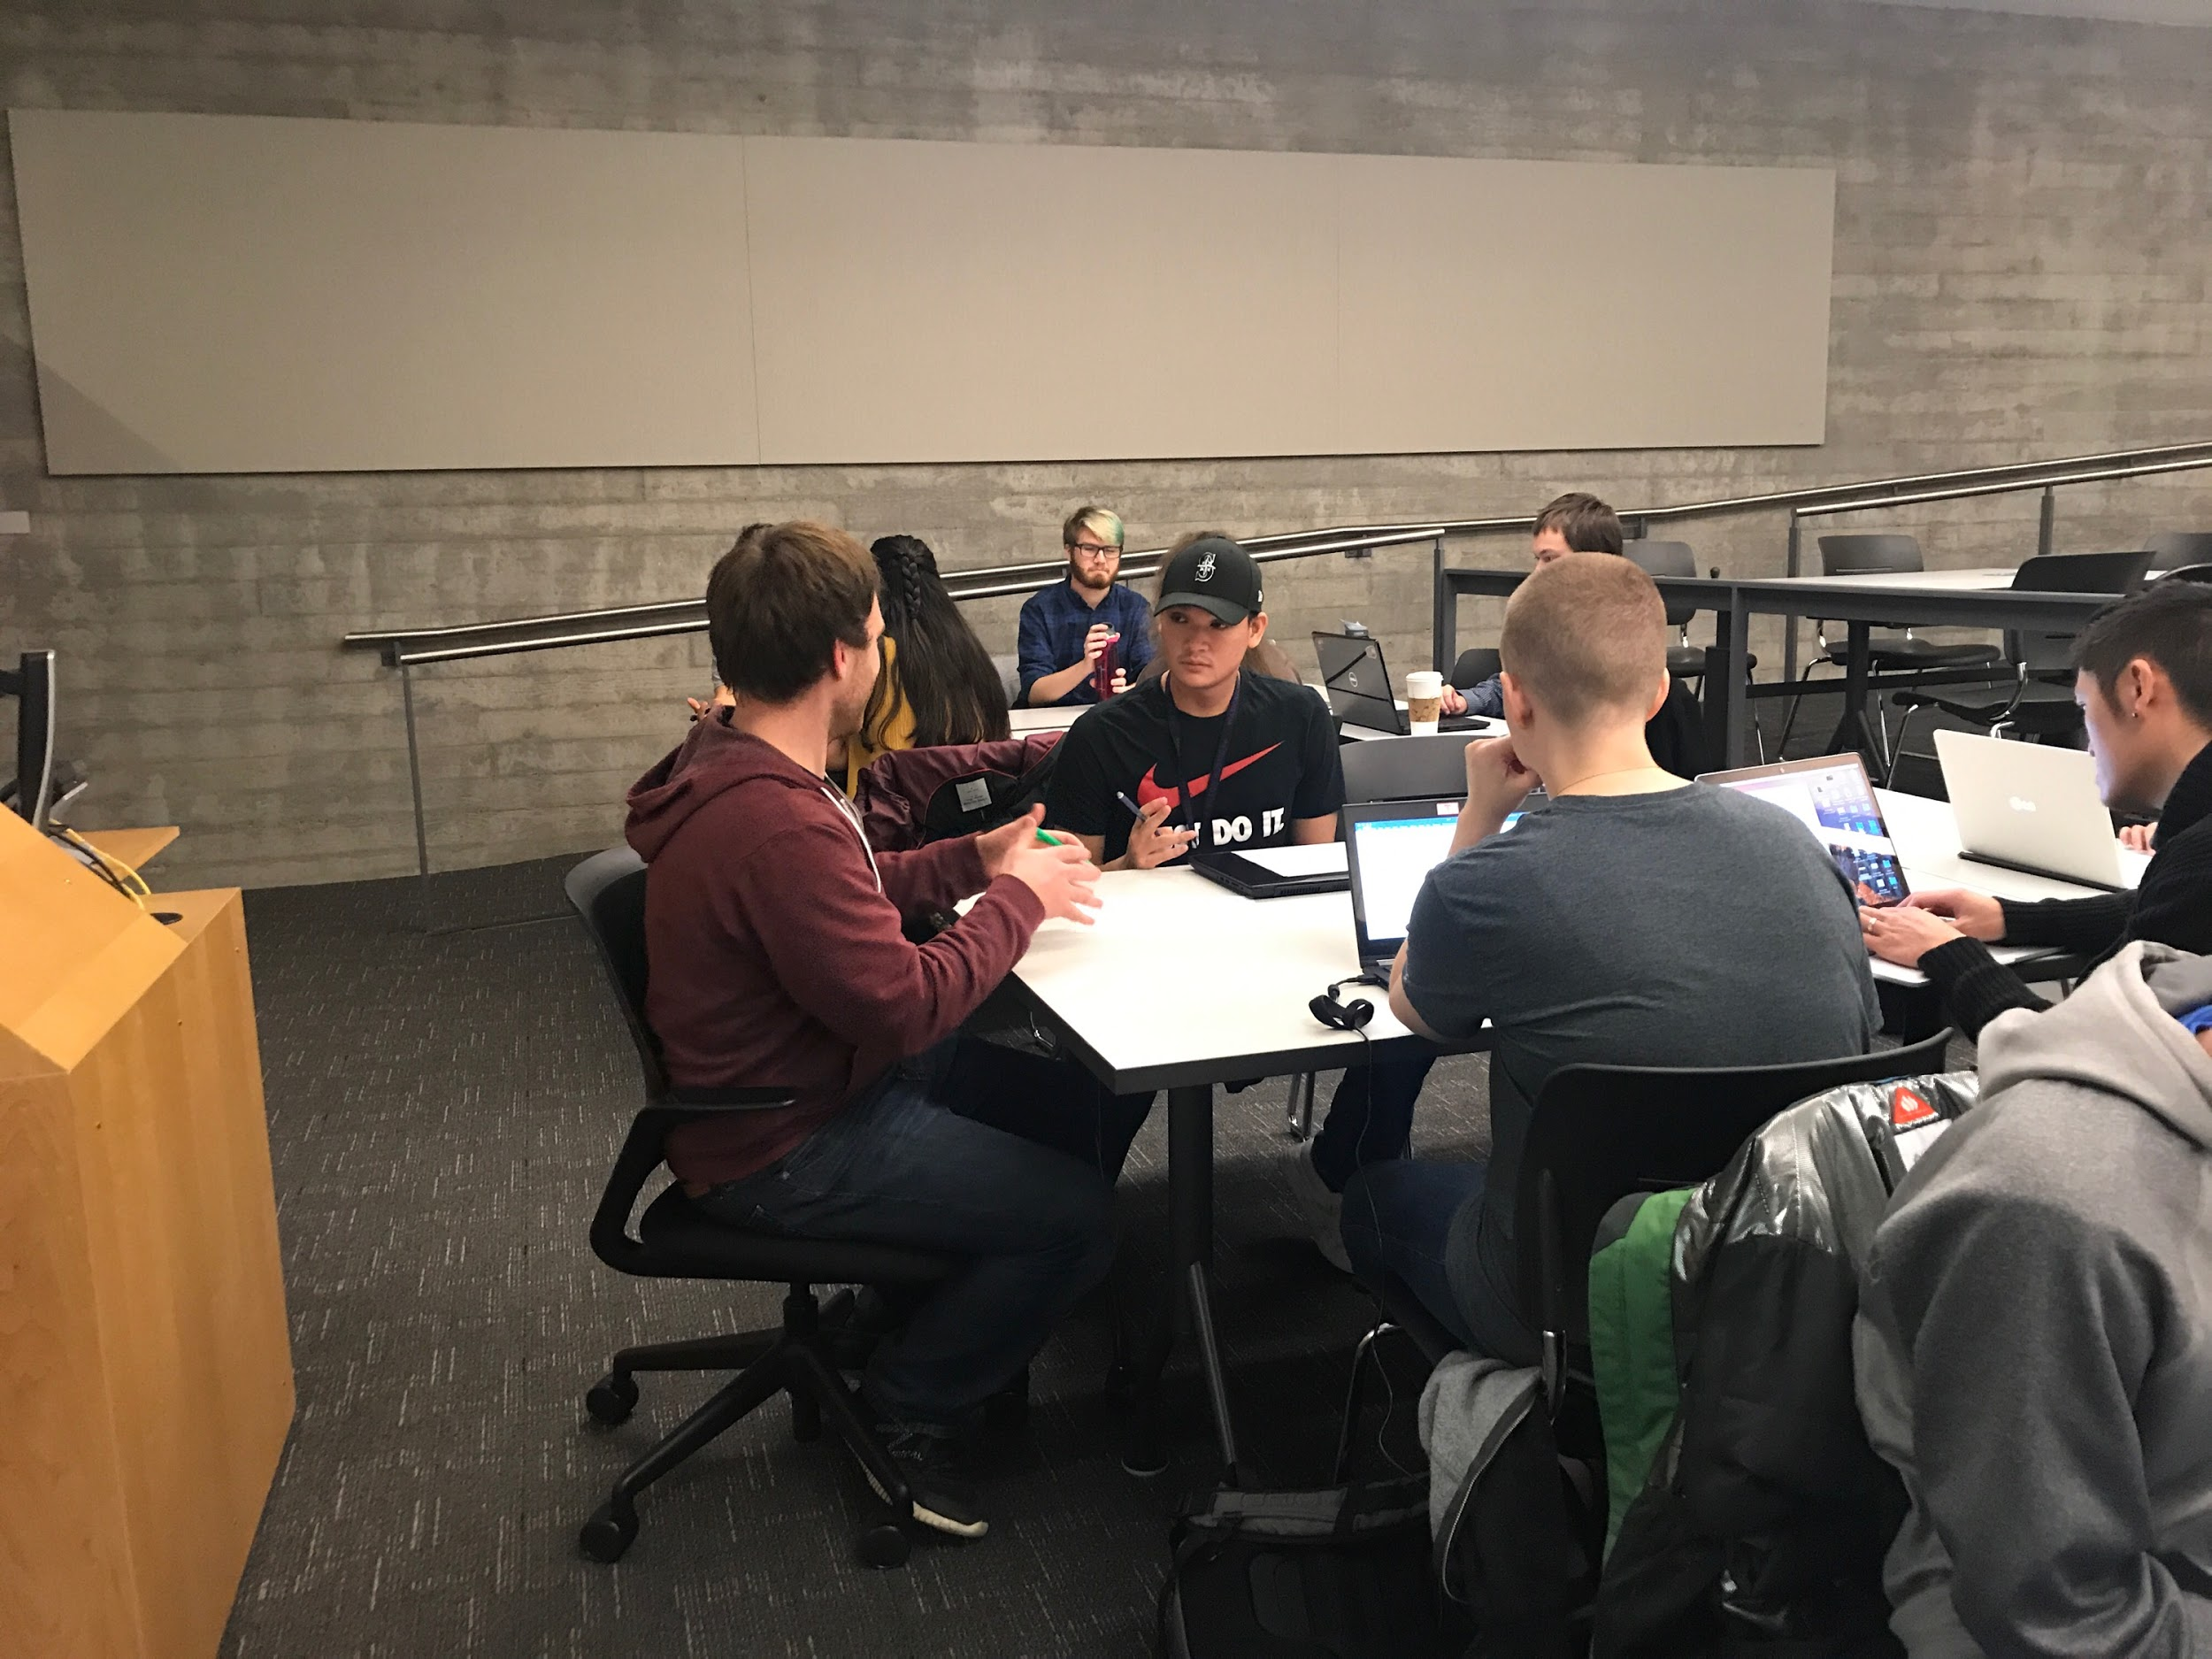
Past Events - Technical Resume Workshop

Slide 7
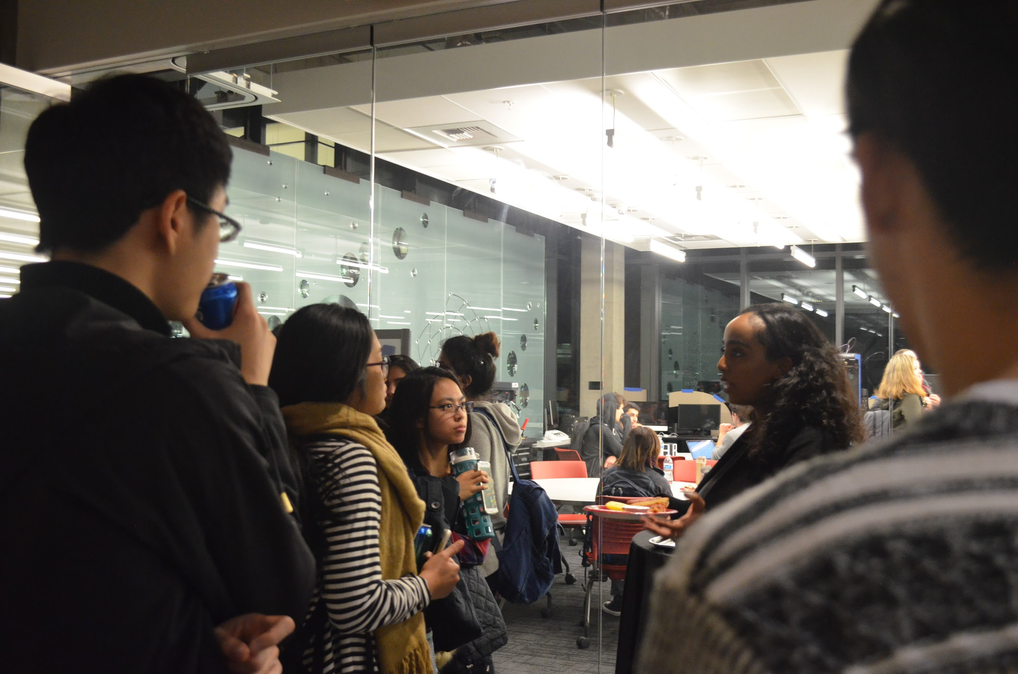
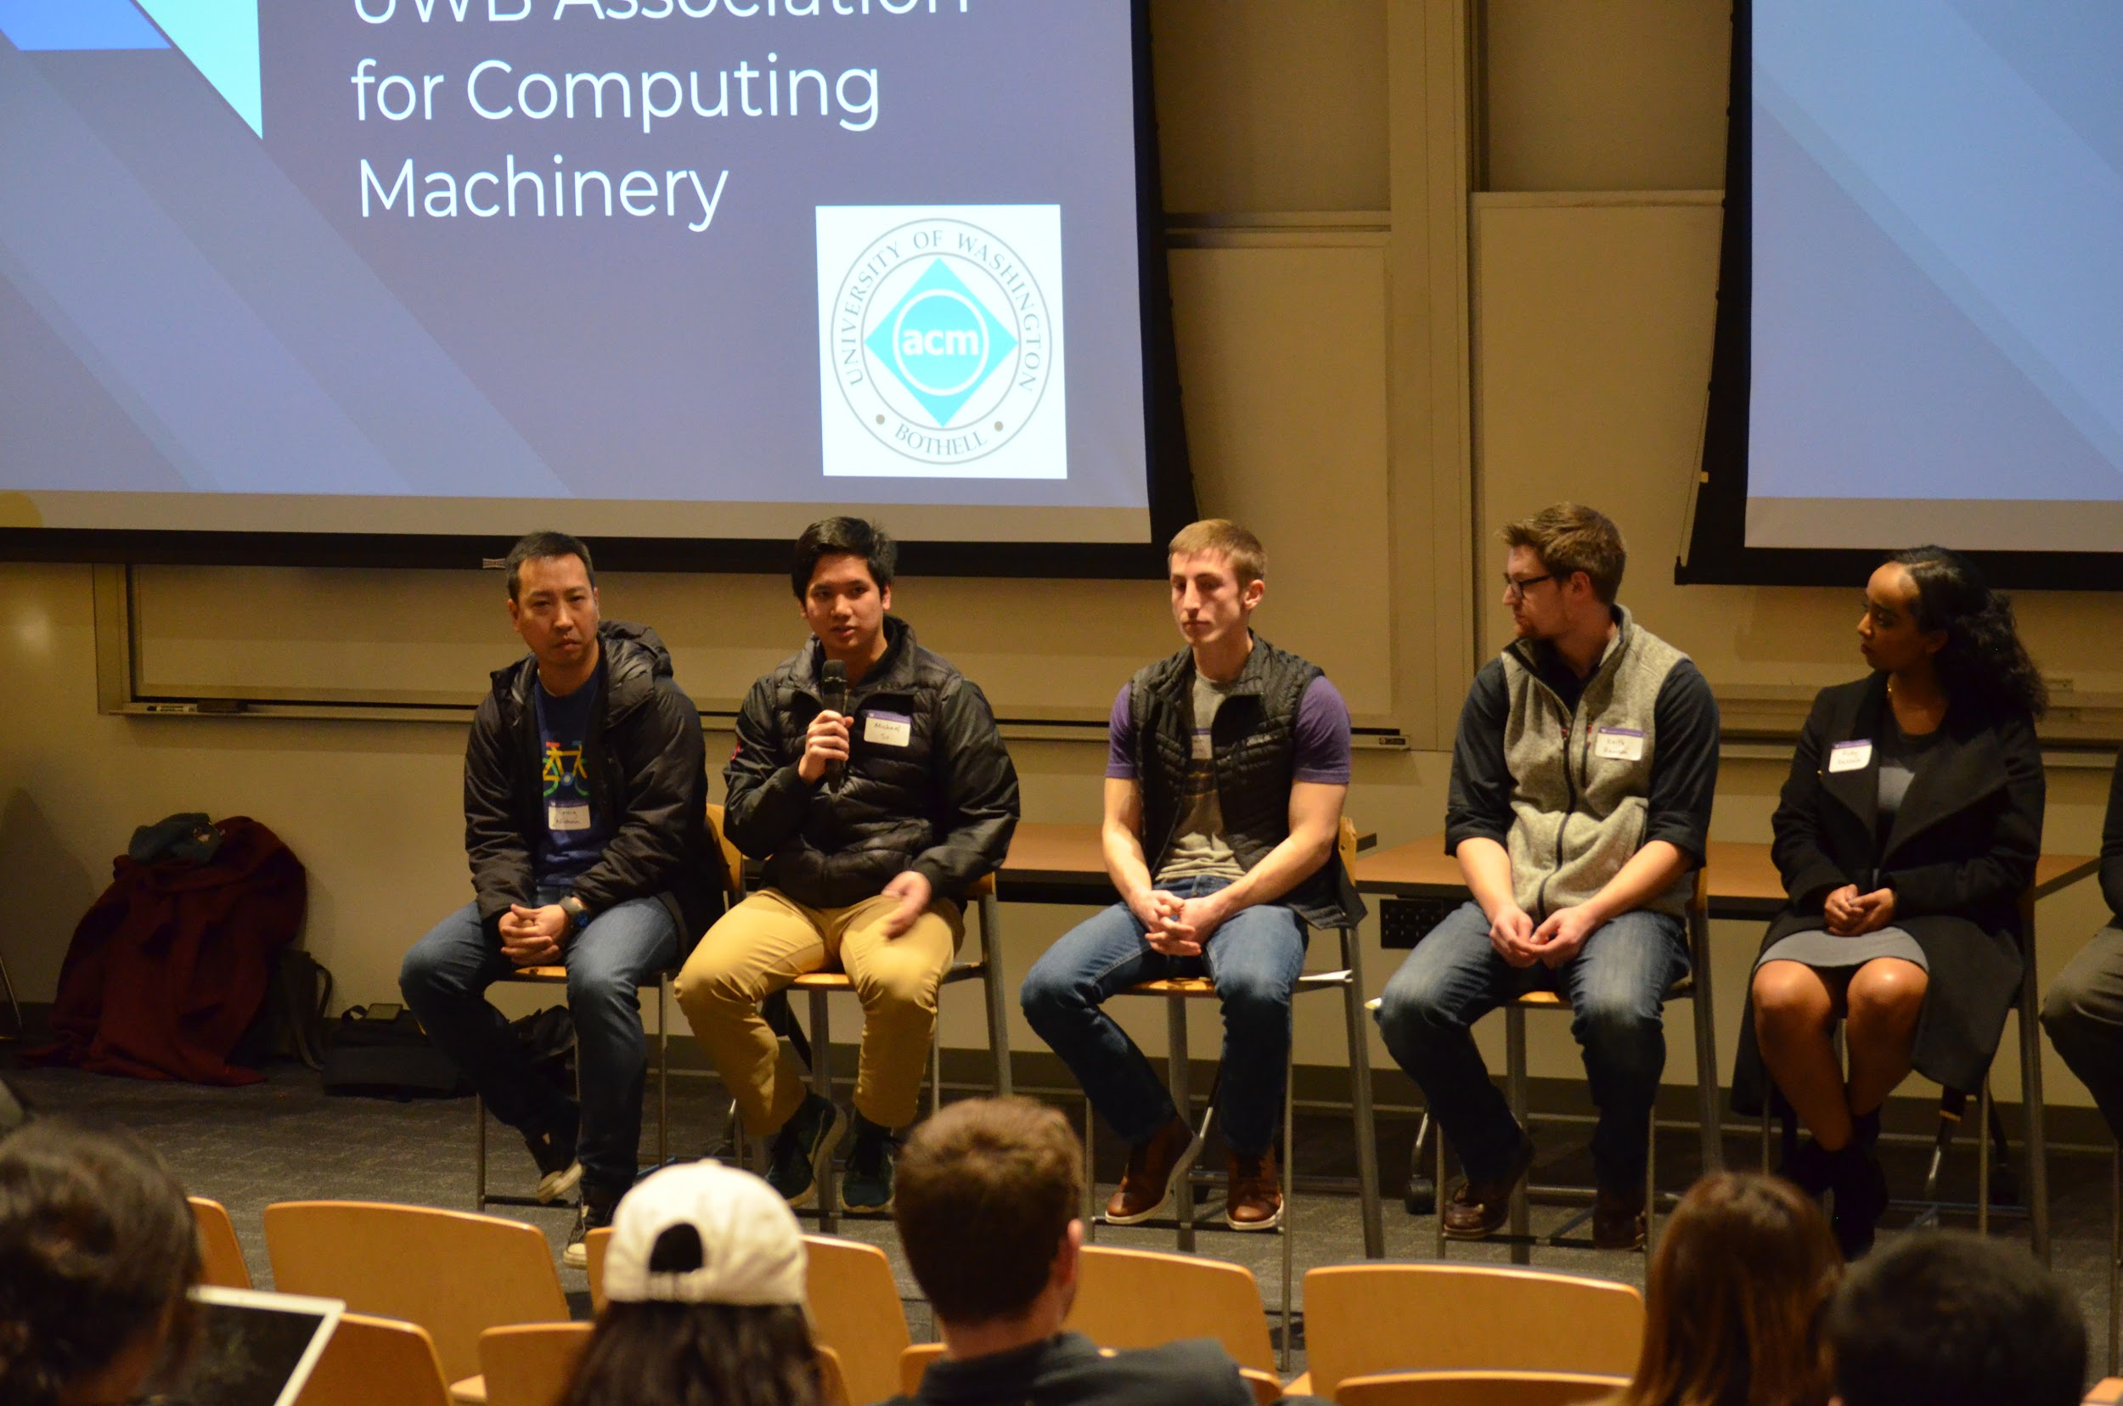
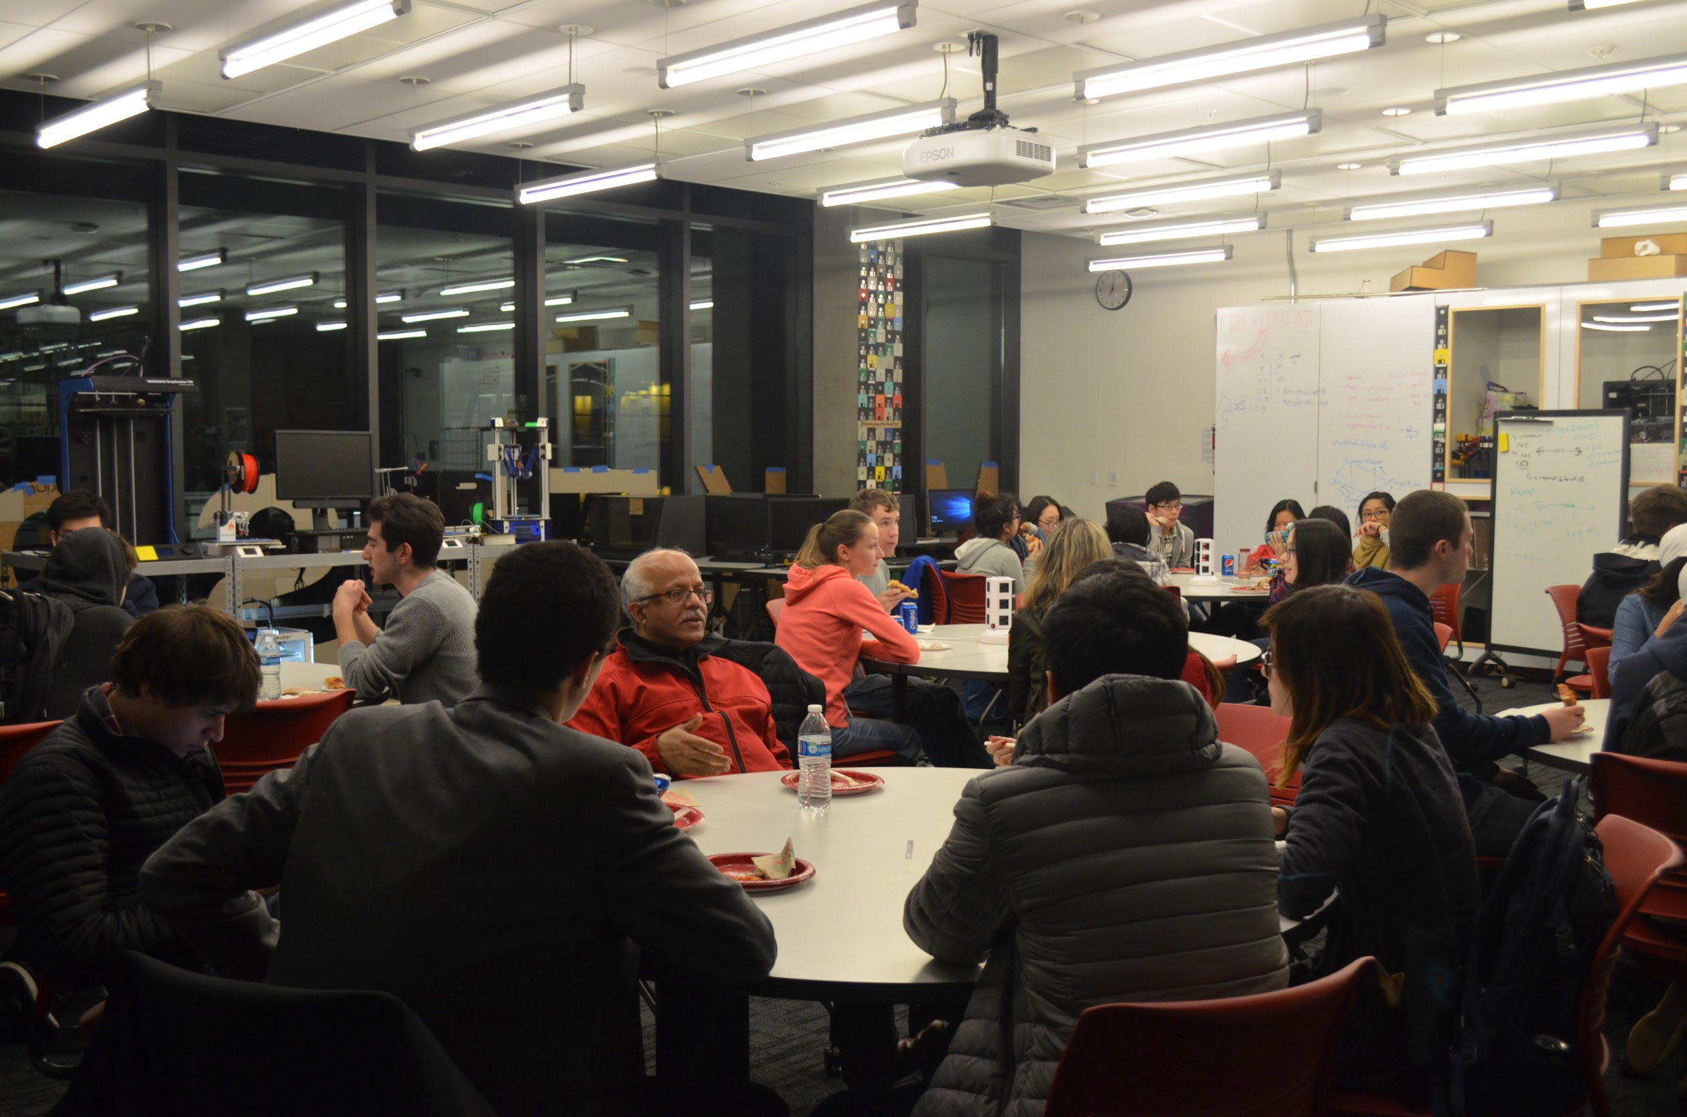
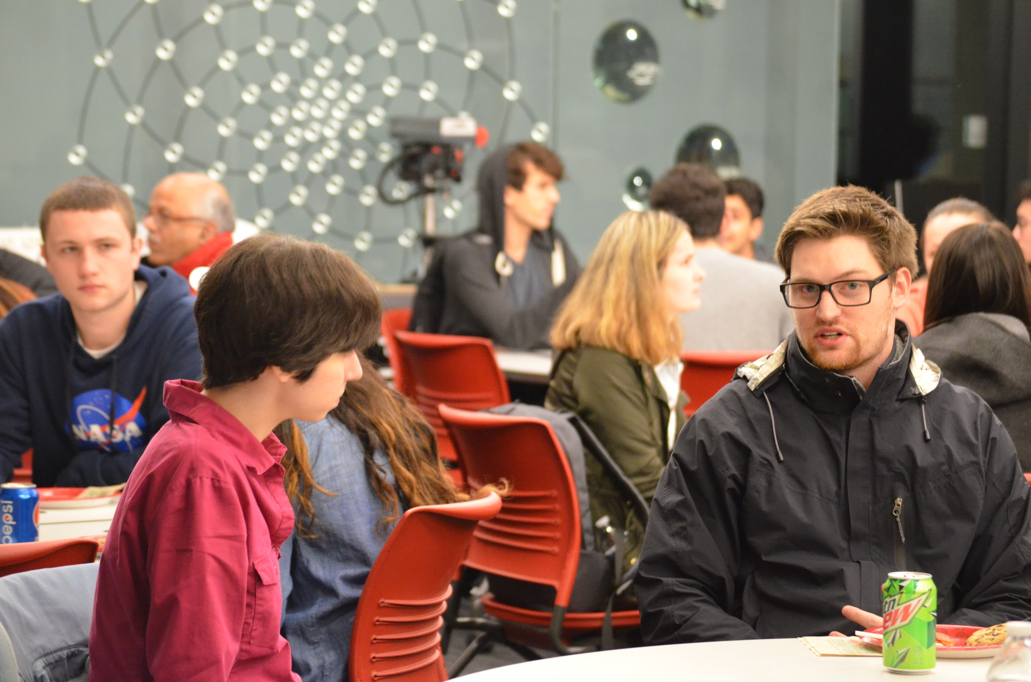
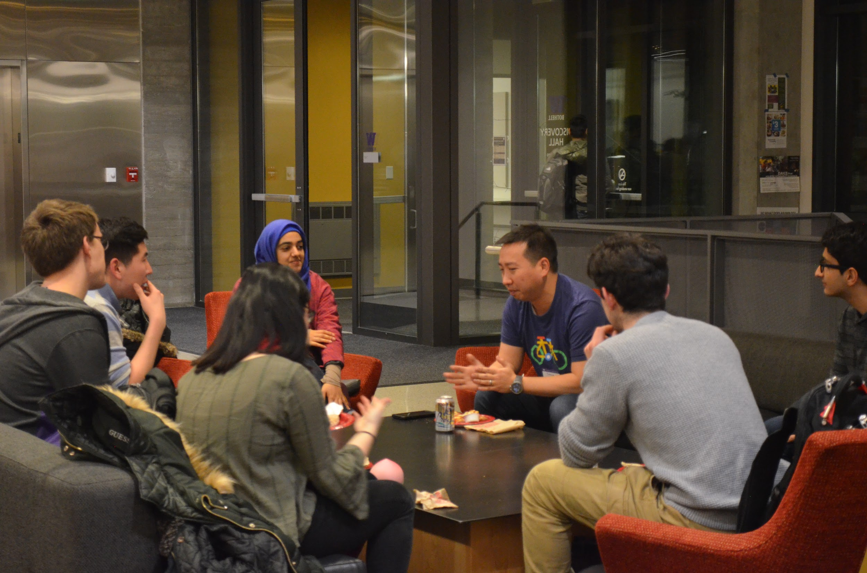
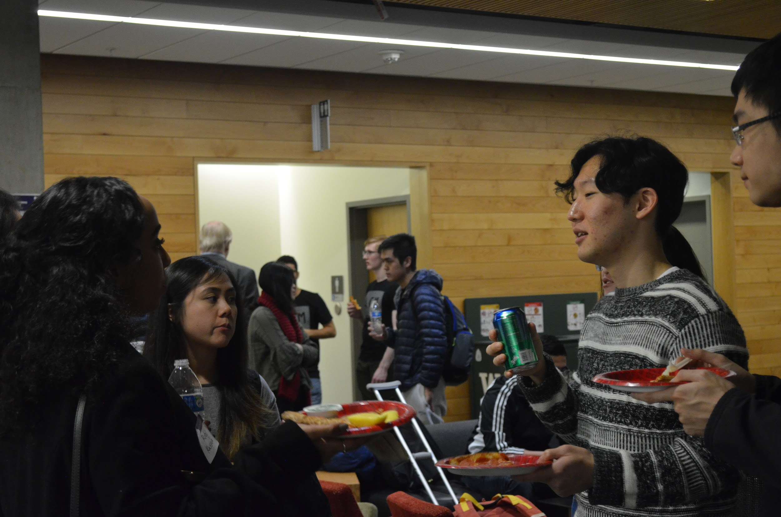
Past Events - Tech Industry Panel & Networking Mixer

Slide 8
Fall UWB ACM Events
Weekly Crack the Coding Interview Workshops
Weekly IOT Crash Courses
2 Linux Crash Courses
3 Professional Workshops
Mock Interview
Fall Quarter Finals Study Session

Slide 9
Join UWB ACM
Visit our website to join our mailing list: www.uwbacm.com
Connect with our LinkedIn: https://www.linkedin.com/in/uwbacm/
If you have any questions, email us at acmuwbothell@gmail.com

